Slide 1


FINANCE &
SUPPLY CHAIN/F&O
Orlando, FL
October 19-23, 2025

Slide 2
Mastering X++ Development: Expert Tips, Tools, and Techniques.
60 tips in 60 minutes

Slide 3


Nathan Clouse
Sr. Director, D365 Solutions
WineShipping
Email: nathan.clouse@gmail.com
Blog #1: https://www.atomicax.com
Blog #2: https://www.dynamics.fo
GitHub: https://github.com/NathanClouseAX
@NathanClouseAX on most platforms
Background:
Awarded Microsoft MVP in Business Applications since 2019
Been working with AX since 2009
Been working with D365FO since 2017
Have spoken at Summit, Focus, and local chapters around various AX/D365FO technical topics plus other groups events

Slide 4

Peter Ramer
Director of Managed Application Services
RSM
Email: peter.ramer@rsmus.com
Blog: http://dynamics365musings.com/
LinkedIn | Microsoft MVP Profile
Background:
Awarded Microsoft MVP in Business Applications since 2022
Been working with AX since 2006
Have written code that was then purchased and included into the standard F&O product.
Have a blog and YouTube channel that contains lots of technical tutorials.

Slide 5

Coding Tips
D365FO.Tools
Quality of Life Hacks
Debugging
Visual Studio Hidden

Slide 6
Coding Tips

Slide 7

Use Set Based Operations
Update_recordset rather than while select w/ update
RecordInsertList rather looped inserts
RecordInsertList rather than insert_recordset
Delete_from rather than while select update
Use new(ish) SysDA APIs
How To Insert Data In D365
How To Update Data In D365
How To Use Insert_recordset in D365
How To Use InsertDatabase in D365
D365 TTSBegin and TTSCommit

Slide 8
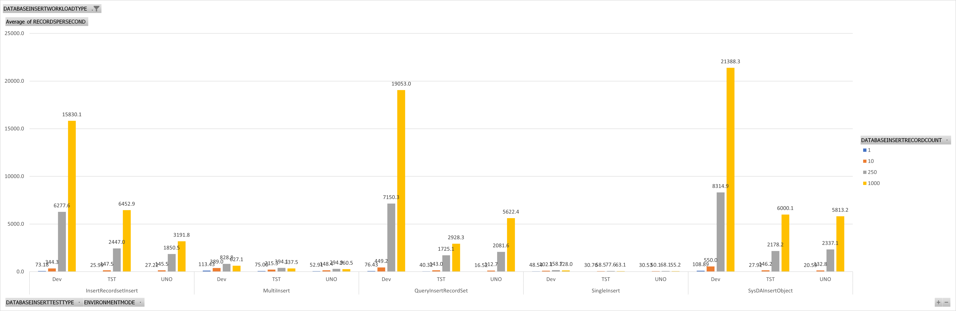
Set Based Operations

Slide 9
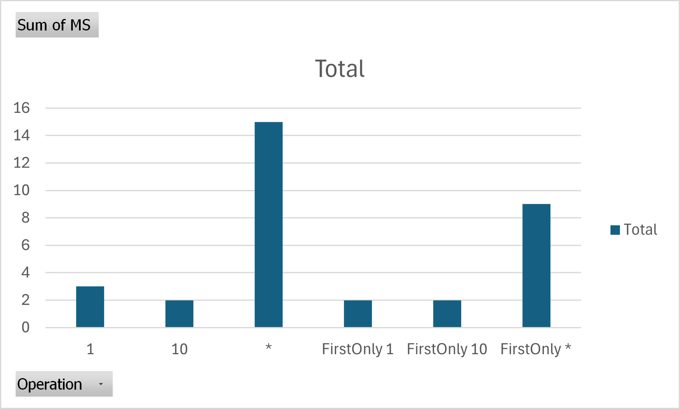
Does specifying columns matter? (and also FirstOnly)

Slide 10
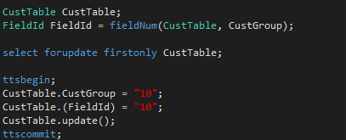

Using FieldNum Ordinals
Standard: CustTable.AccountNum
Using Ordinals: CustTable.(fieldNum(CustTable,AccountNum))

Slide 11
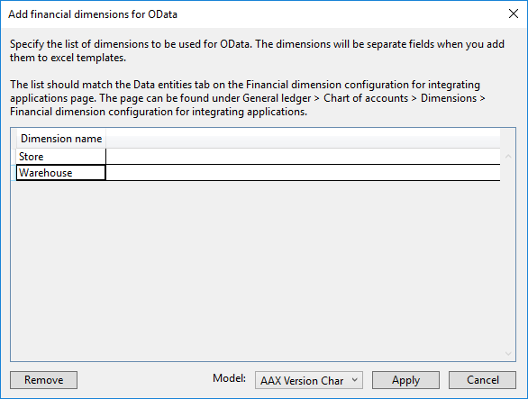

Add Financial Dimension for OData
Dynamics 365 > Addins > Add financial dimensions for OData

Slide 12
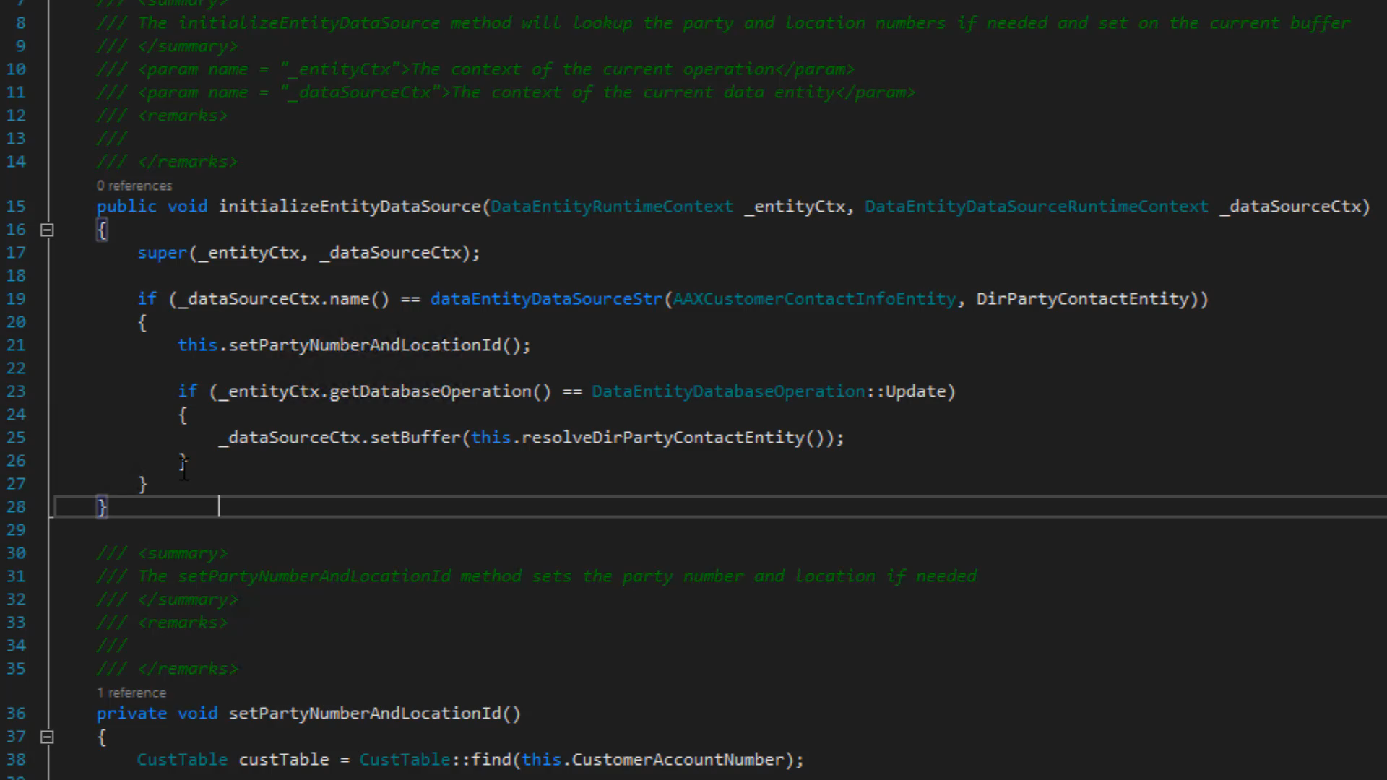

Comment Code

Slide 13

Go To (Main Thing)
Hit F9 in design view to go to the main thing for the item selected
F9 on a table extension will take you to the base table
F9 on a field will take you to the EDT
F9 on a field with a relationship will take you to the related table
F9 on a field in a data entity will open the table/entity for that field
F9 on COC Extension Class will take you to the main class

Slide 14
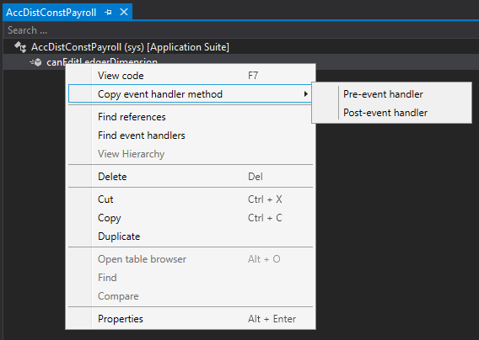

Copy Event Handlers - Methods
In design view, expand methods, right click, copy event handler

Slide 15
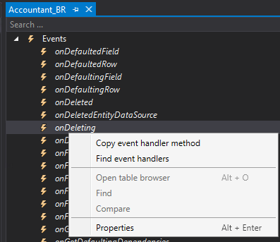
Copy Event Handler - Events
In design view, expand events, right click, copy event handler

Slide 16
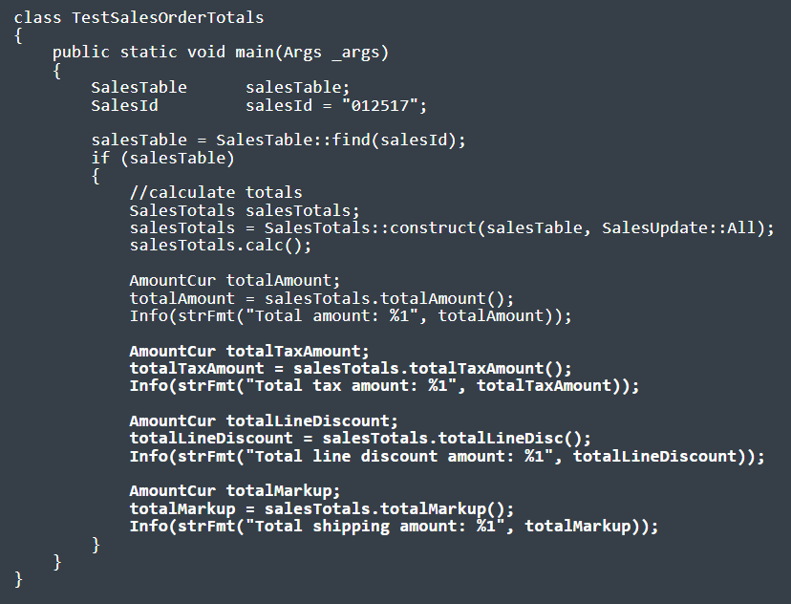

Sales order Totals
https://dynamics365musings.com/d365-sales-order-totals/

Slide 17

Extensible Controls
https://www.youtube.com/watch?v=QrIjTN6Vey4&t=149s
https://sangeethwiki.blogspot.com/2017/09/extensible-controls-in-dynamics-365-for.html
Use Javascript and html to create your own D365 controls.

Slide 18
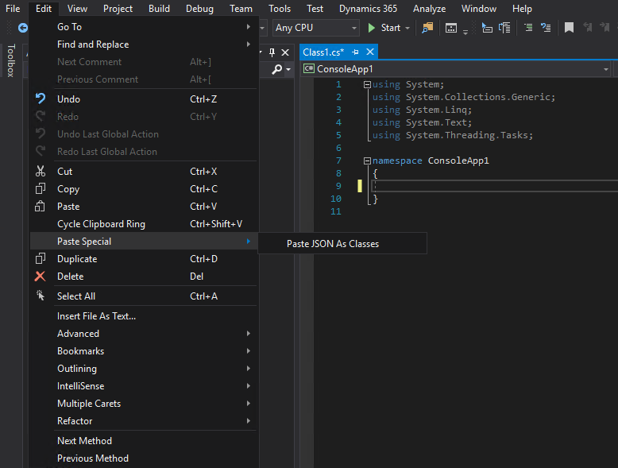

Paste Special
Edit > Paste Special
XML as Class
JSON as Class

Slide 19

Paste Special
{"menu": {
"id": "file",
"value": "File",
"popup": {
"menuitem": [
{"value": "New", "onclick": "CreateNewDoc()"},
{"value": "Open", "onclick": "OpenDoc()"},
{"value": "Close", "onclick": "CloseDoc()"}
]
}
}}
public class Menu
{
public string id { get; set; }
public string value { get; set; }
public Popup popup { get; set; }
}
public class Popup
{
public Menuitem[] menuitem { get; set; }
}
public class Menuitem
{
public string value { get; set; }
public string onclick { get; set; }
}

Slide 20
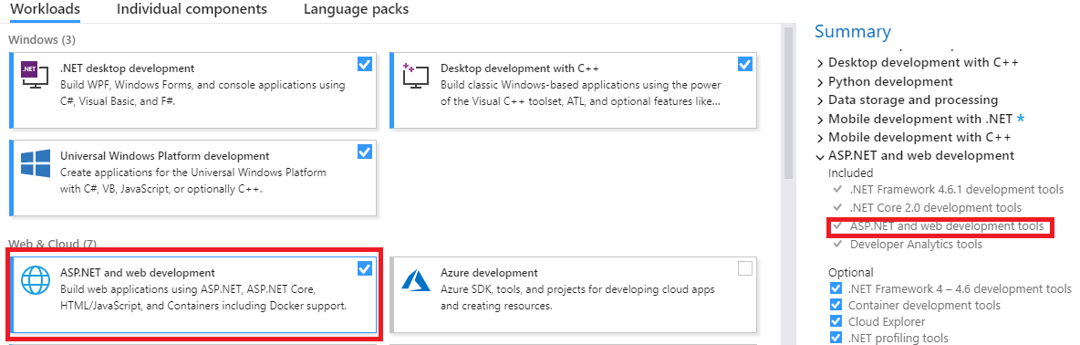
If XML Option Missing…
Add ASP.NET to VS

Slide 21
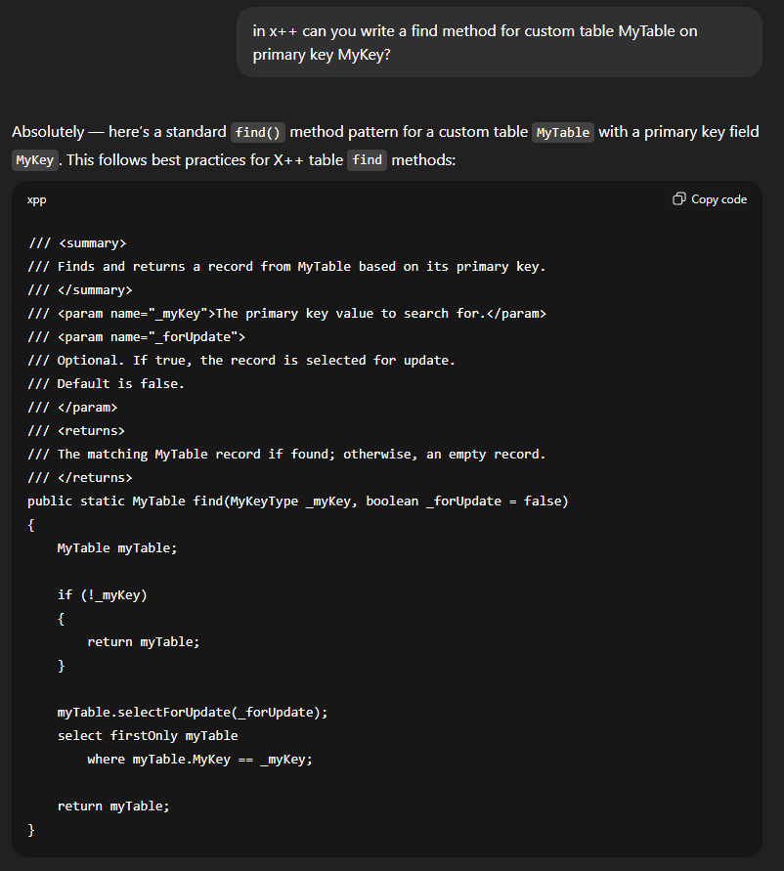
Mandatory Slide about AI

Slide 22
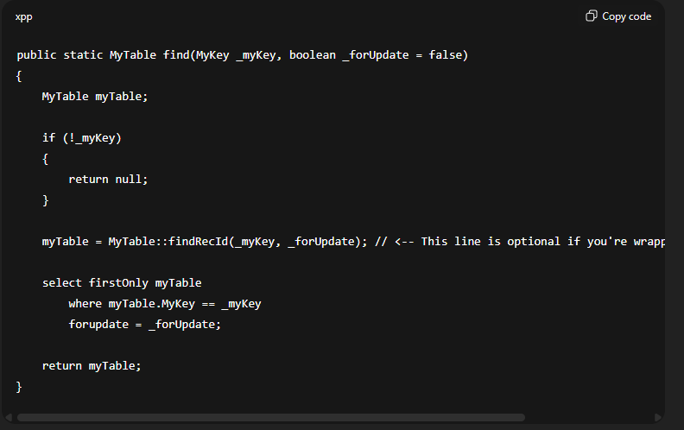
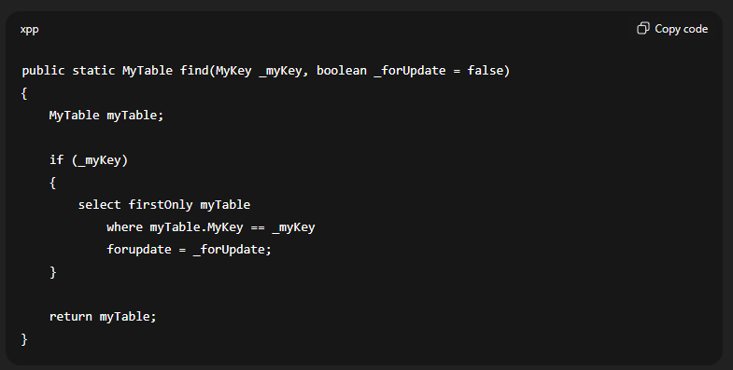
It really tries

Slide 23

CrossCompany
static void JobDemoCrossCompany(Args _args)
{
BankAccountTable tabBAT; // saveDataPerCompany == true.
container conCompanies = [ 'cm1', 'cm2', 'dat' ];
str 4 sCompanyPrevious = " "; // Maximum length is 4 characters.
int iCountCompanies = 0;
;
while select
crossCompany
: conCompanies
* from tabBAT
order by dataAreaId
{
if ( sCompanyPrevious != tabBAT.dataAreaId )
{
info( tabBAT.dataAreaId + " = tabBAT.dataAreaId" );
iCountCompanies++;
if ( iCountCompanies >= 2 )
{
break;
}
sCompanyPrevious = tabBAT.dataAreaId;
}
}
return;
}

Slide 24
CrossCompany
BankAccountTable tabBAT; // saveDataPerCompany == true.
container conCompanies = [ 'cm1', 'cm2', 'dat' ];
str 4 sCompanyPrevious = " "; // Maximum length is 4 characters.
int iCountCompanies = 0;
;
while select
crossCompany
: conCompanies
* from tabBAT
order by dataAreaId
{
…
}
return;
}

Slide 25
CrossCompany Queries
static void JobDemoAllowCrossCompany(Args _args)
{
BankAccountTable tabBAT; // saveDataPerCompany == true.
Query qry2;
QueryBuildDataSource qbds3;
QueryRun qrun4;
str sCompanyPrevious = " ";
int iCountCompanies = 0;
int iTableNumBAT;
;
qry2 = new Query();
qry2.allowCrossCompany( true );
qry2.addCompanyRange( 'dat' );
qry2.addCompanyRange( 'twf' );
iTableNumBAT = tableNum( BankAccountTable );
qbds3 = qry2 .addDataSource( iTableNumBAT );
//qbds3.company( 'dat' );
qrun4 = new QueryRun( qry2 );
while ( qrun4.next() )
{
if ( qrun4.changed( iTableNumBAT ) )
{
tabBAT = qrun4.get( iTableNumBAT );
if ( sCompanyPrevious != tabBAT.dataAreaId )
{
print( tabBAT.dataAreaId + " = tabBAT.dataAreaId" );
iCountCompanies++;
if ( iCountCompanies >= 2 )
{
break;
}
sCompanyPrevious = tabBAT.dataAreaId;
}
}
}
pause;
return;
}

Slide 26
CrossCompany Queries
BankAccountTable tabBAT; // saveDataPerCompany == true.
Query qry2;
QueryBuildDataSource qbds3;
QueryRun qrun4;
str sCompanyPrevious = " ";
int iCountCompanies = 0;
int iTableNumBAT;
;
qry2 = new Query();
qry2.allowCrossCompany( true );
qry2.addCompanyRange( 'dat' );
qry2.addCompanyRange( 'twf' );

Slide 27

Use C#
X++ is good but what it can’t do, C# can do
  Call an external web service
  Handle JSON/XML tedium
  FTP

Slide 28
Use C#
class AAX_AzureQueueTest
{
const str connectionString = "Endpoint=sb://[urlName]servicebus.windows.net/;SharedAccessKeyName=[SharedAccessName];SharedAccessKey=[SharedAccessKey]=;EntityPath=[QueueName]";
public static void main(Args args)
{
AAX_AzureQueueLibrary.ReceiveAzureQueue ReceiveAzureQueue = new AAX_AzureQueueLibrary.ReceiveAzureQueue();
AAX_AzureQueueLibrary.SendAzureQueue SendAzureQueue = new AAX_AzureQueueLibrary.SendAzureQueue();
//x++ get a guid, not C#
str s = "Test Message " + WinAPIServer::createGUID();
SendAzureQueue.connect(connectionString);
SendAzureQueue.sendMessage(s);
SendAzureQueue.close();
info(strFmt("sent: %1", s));
s = "";
ReceiveAzureQueue.connect(connectionString);
s = ReceiveAzureQueue.readMessage();
ReceiveAzureQueue.completeMessage();
ReceiveAzureQueue.close();
info(strFmt("Received: %1", s));
}
}

Slide 29

Other Stuff
Can’t locate an error that is being thrown? Add a breakpoint in info.Add() (on switch (logLevel))
Use funcName() to help with figuring problems out
QueryBuildDataSource.toString() to see the SQL for a query
Data Entities can be temperamental; DB Sync, delete entity (from Data Entity Screen), rebuild list, test again

Slide 30
D365 X++ Developer Playlist
https://dynamics365musings.com/d365-development-learning-playlist/

Slide 31
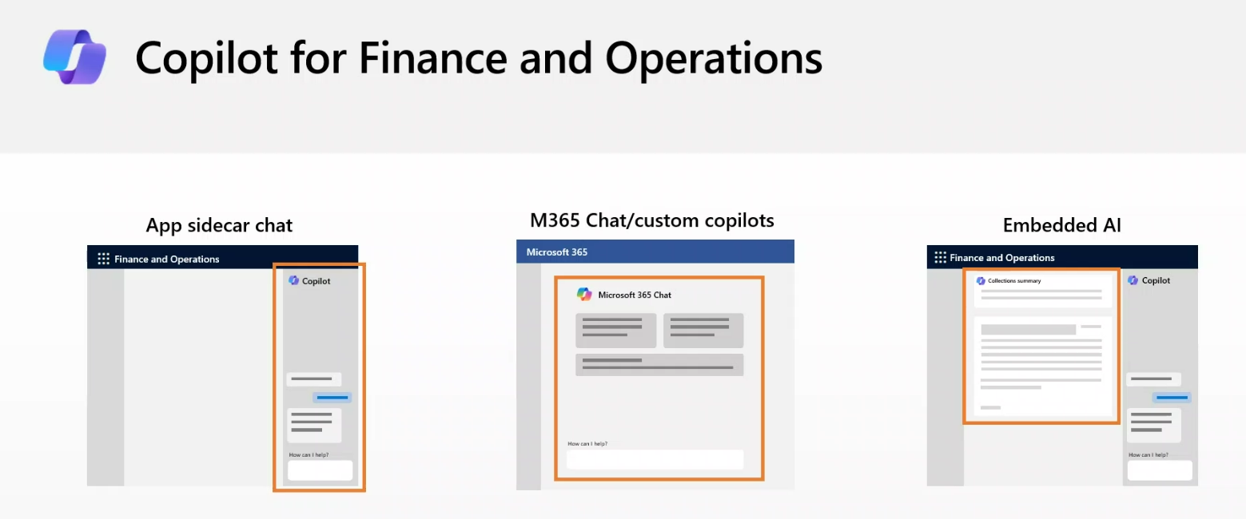

Extend Copilot capabilities
https://learn.microsoft.com/en-us/dynamics365/fin-ops-core/dev-itpro/copilot/extend-copilot

Slide 32
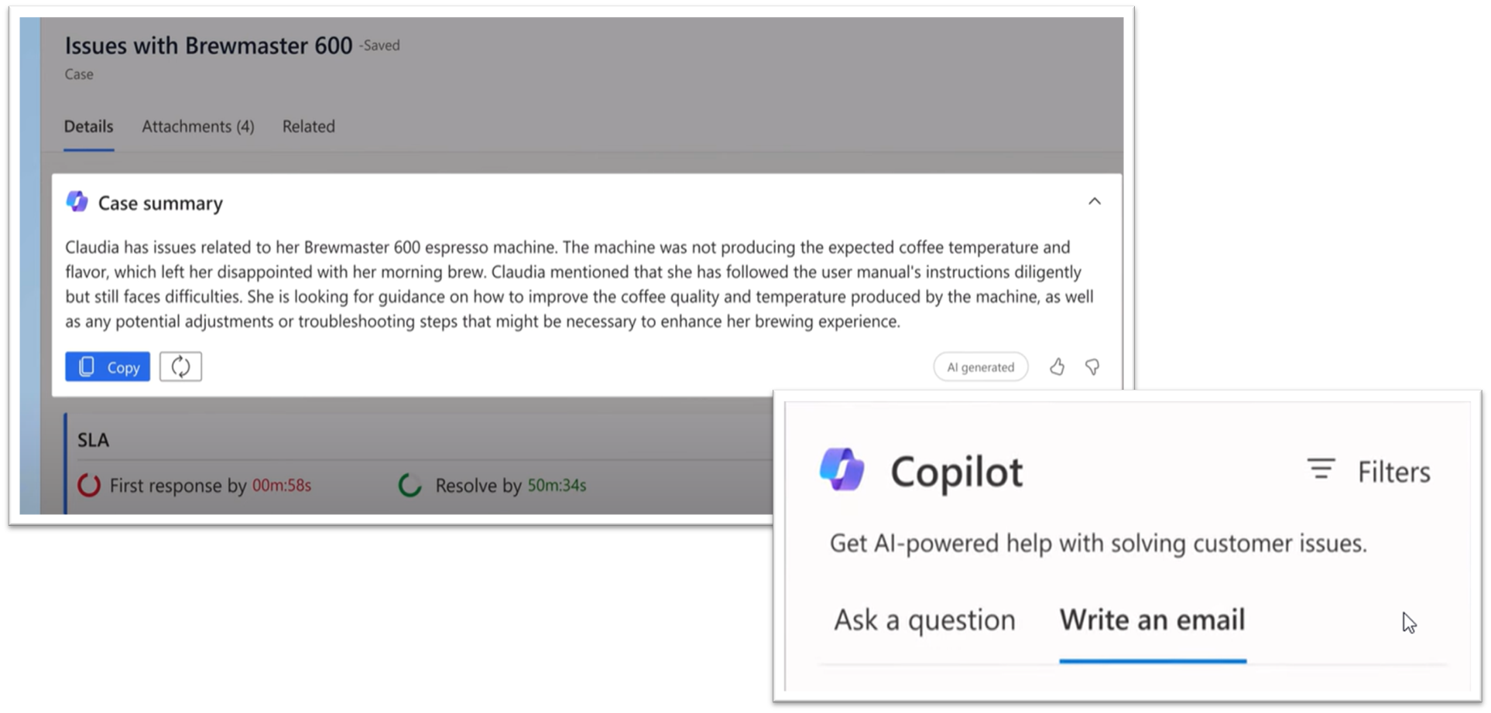
Copilot capabilities

Slide 33
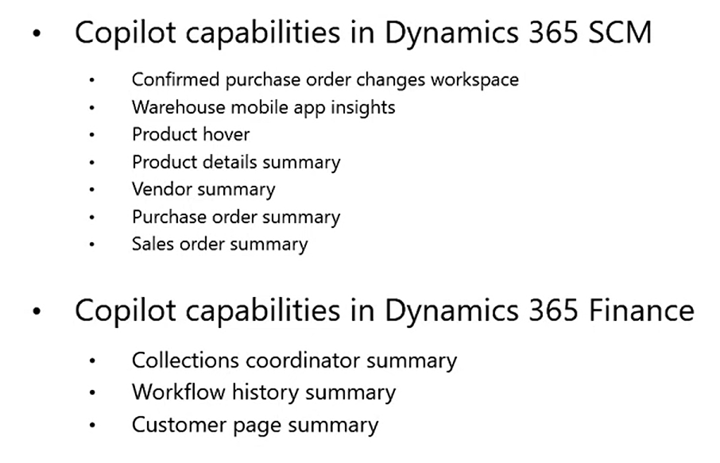
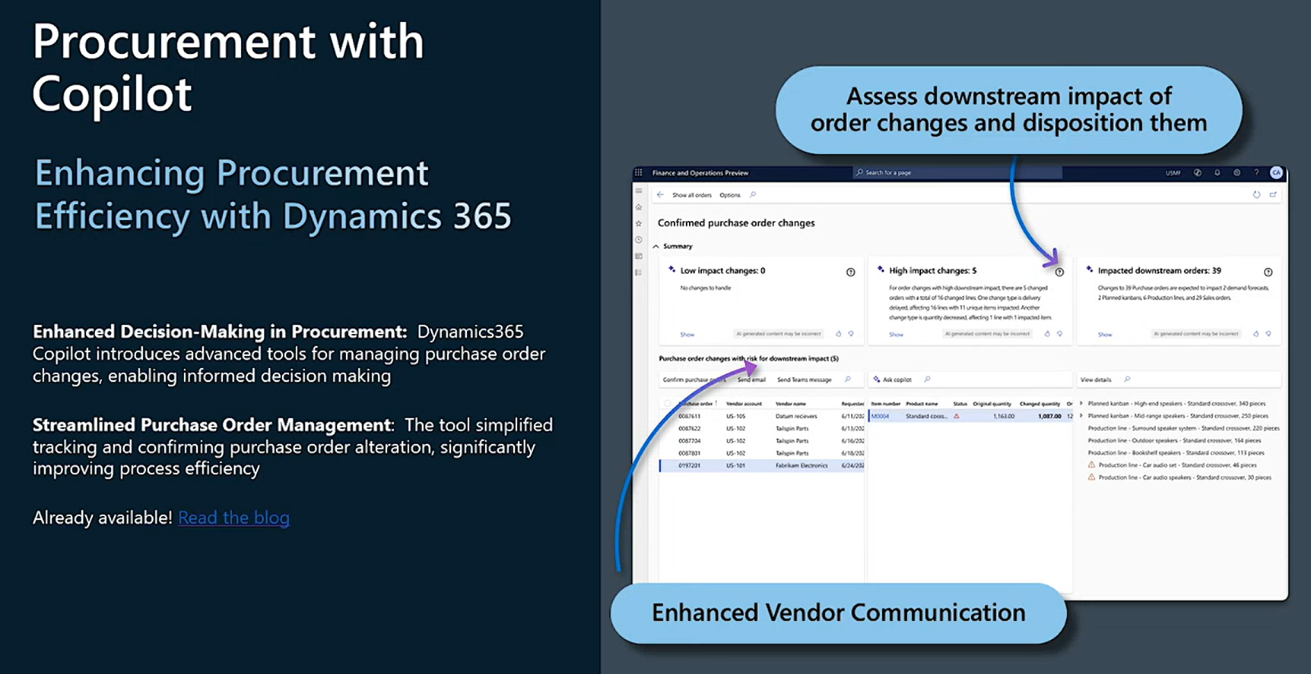
Copilot capabilities

Slide 34
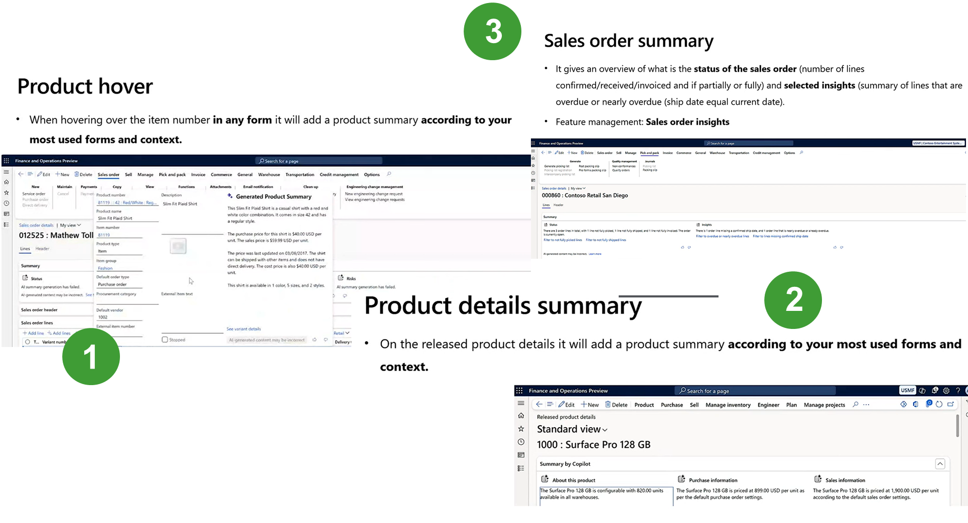
Copilot capabilities

Slide 35

Use Batch Jobs
Top Picking: https://www.atomicax.com/blog-entry/batchretryable-top-picking-batch-job-example
Bundles: https://www.atomicax.com/blog-entry/batchretryable-bundled-batch-job-example
Induvial Task Models: https://www.atomicax.com/blog-entry/batchretryable-individual-task-modeled-batch-job-example
“Classic”: https://www.atomicax.com/blog-entry/batchretryable-runbasebatch-class
Also review Process Automations

Slide 36

Misc Grab Bag
Use buf2Buf() for copying the contents of one buffer to another.
1
Apply select firstOnly1 when you expect a single record to optimize performance.
2
Use Views rather than doing complex joins in a query statement (when performance is not critical)
3

Slide 37
D365FO.Tools

Slide 38
Quality Of Life

Slide 39

Copy data from excel to D365 grid
https://learn.microsoft.com/en-us/dynamics365/fin-ops-core/fin-ops/get-started/grid-capabilities
Just copy and paste.
Plus, lots of other features (Enabled in Feature Management)

Slide 40

Table Browser
https://dynamics365musings.com/d365-table-browser/
https://<environmentURL>/?mi=SysTableBrowser&tablename=<tablename>

Slide 41
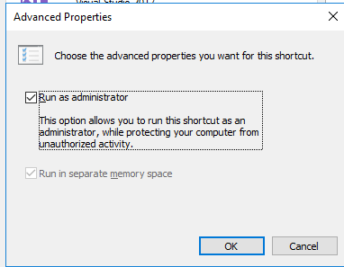
Run Visual Studio as Admin
Start
Search for Visual Studio 2017
Right click > Open file location
Find icon, right click > Properties > Advanced
Check “Run As Administrator”

Slide 42

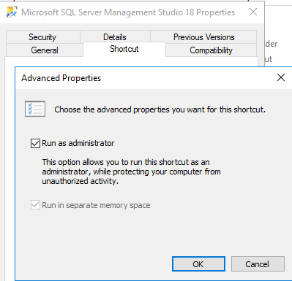
Run SSMS as Admin
Nearly the same as for VS 2017

Slide 43

Extend Archive Framework
https://learn.microsoft.com/en-us/dynamics365/fin-ops-core/dev-itpro/sysadmin/archive-custom#finance-and-operations-table-names-in-live-history-and-dataverse-managed-data-lake-tables
The archival framework supports extensions to include custom table fields and custom tables in supported functional scenarios.
Custom fields that are added to a standard table must be added to the corresponding history table and the business intelligence (BI) entity.
Extend the ArchiveAutomationJobRequestCreator class for a scenario to add the new table to archive table chart.

Slide 44
Querying in SQL w/ nolock
Using NOLOCK when directly querying SQL can show uncommitted records
Useful when debugging
I.e.:
SELECT *
FROM SalesTable WITH (nolock)
WHERE SalesId = ‘SO04381969’
AND DataAreaId = ‘USMF’

Slide 45
Debugging

Slide 46
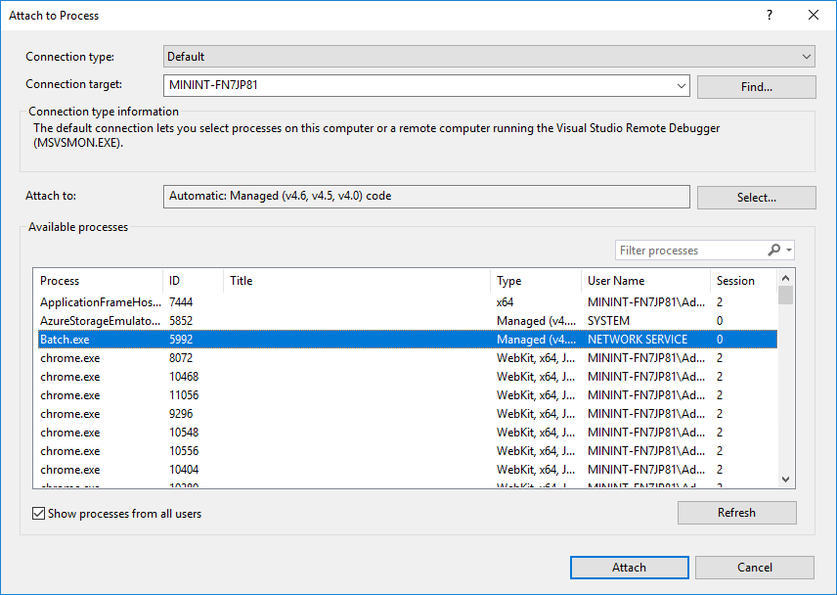

Debugging Batch Jobs
Attached to process
Show all processes from all users
Look for Batch.exe

Slide 47
Debugging with a UDE
Have Breakpoints
Launch the debugger
That’s it.

Slide 48
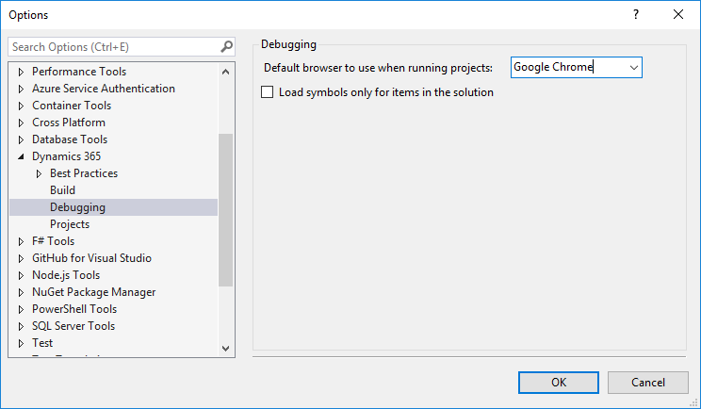
Loading Symbols
Tools > Options

Slide 49
Loading Symbols

Slide 50
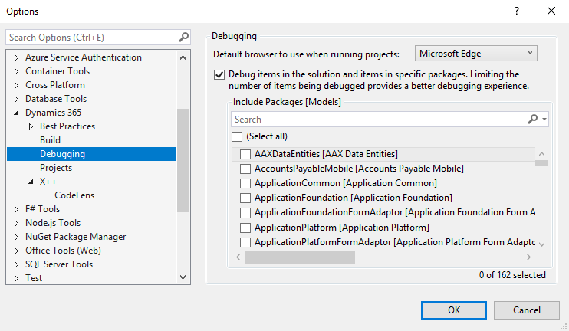
Loading Symbols

Slide 51
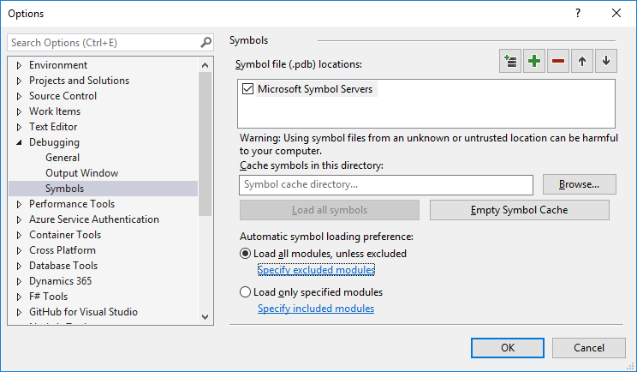

Load all modules

Slide 52
Visual Studio
Hidden Gems

Slide 53
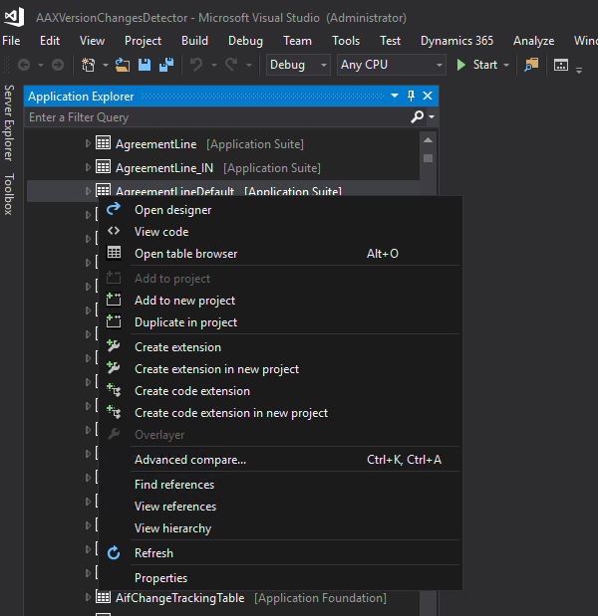

Create code extension
Create code extension

Slide 54
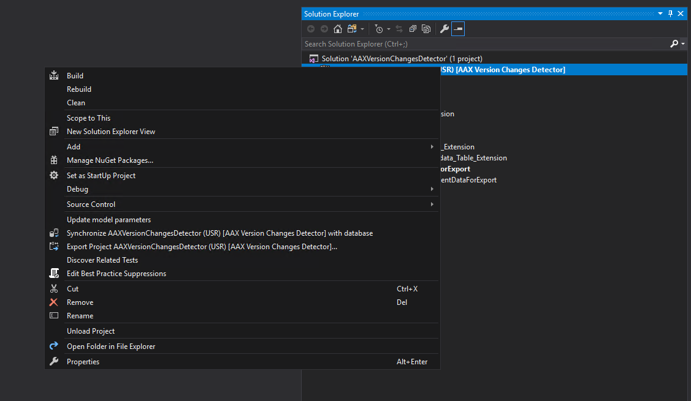
Update Model Parameters
Update model parameters

Slide 55
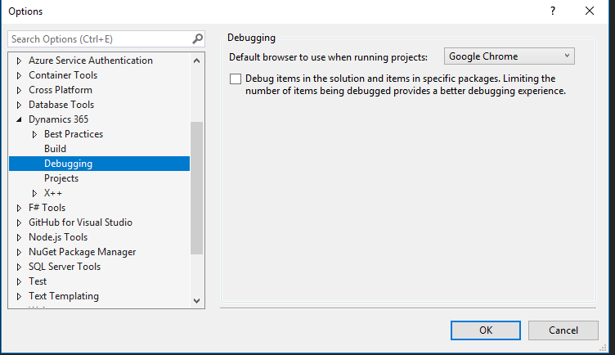
Debug items in solution

Slide 56
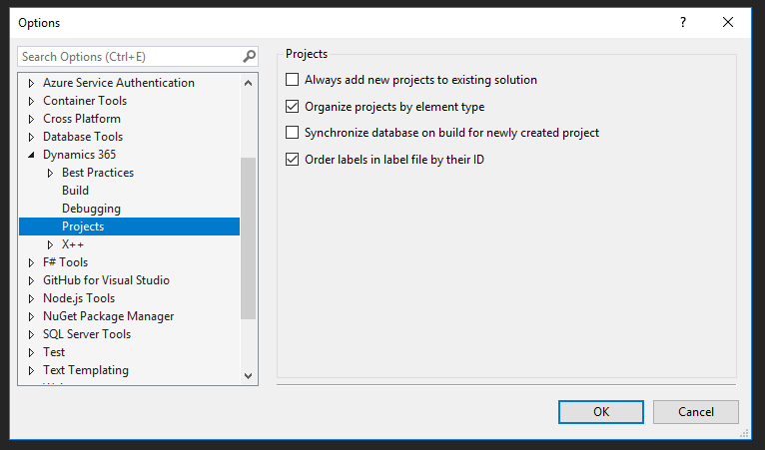
Order Labels in label file by ID

Slide 57
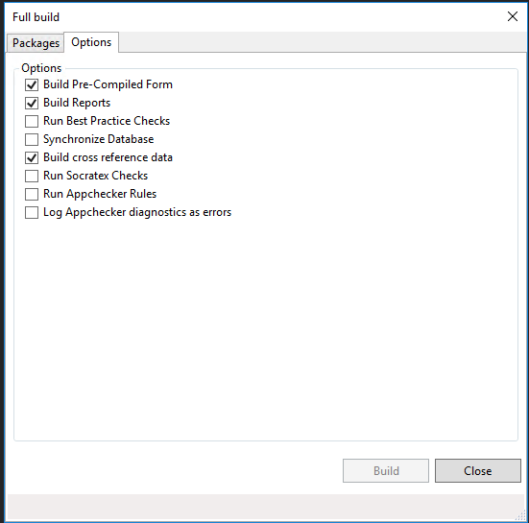
Build Options

Slide 58
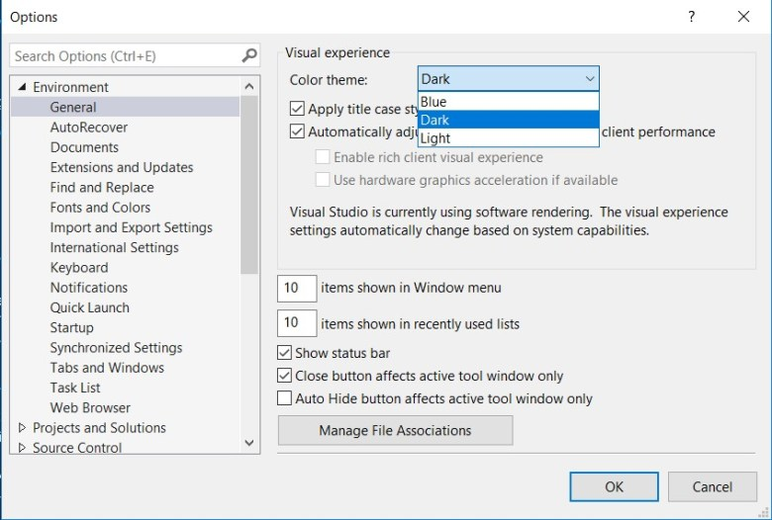

Dark Mode Plus Custom Colors
Notes:
https://jatomas.com/en/2020/05/02/dark-mode-visual-studio-x-code-editor/

Slide 59
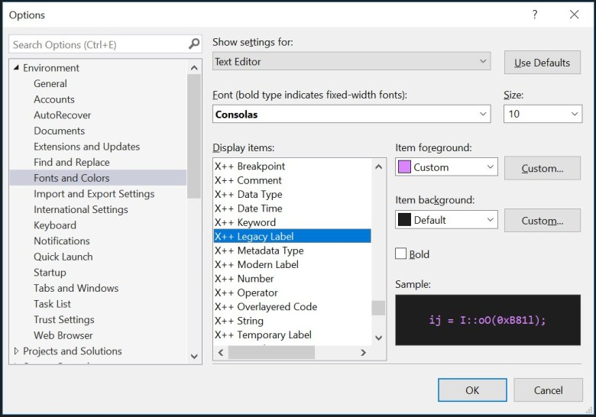
Dark Mode Plus Custom Colors
Notes:
https://jatomas.com/en/2020/05/02/dark-mode-visual-studio-x-code-editor/

Slide 60
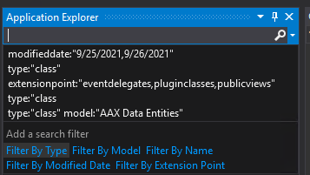

Metadata Search
Search on any option, value, metadata, whatever, on an element
type:"form" ccount
type:"class" extensionpoint:"eventhandlers,eventdelegates"

Slide 61
Metadata Search
type:"dataentityview" property:"PublicCollectionName=CustomerStatisticsGroups"
type:"dataentityview" property:"PublicEntityName=CustomerStatisticsGroup"

Slide 62

TRUDUtilsD365
Open Source
https://github.com/TrudAX/TRUDUtilsD365
Prototyping Tools that help with productivity
Configurable
Similar idea from AX 2009/2012 with configurable MorphX tools

Slide 63
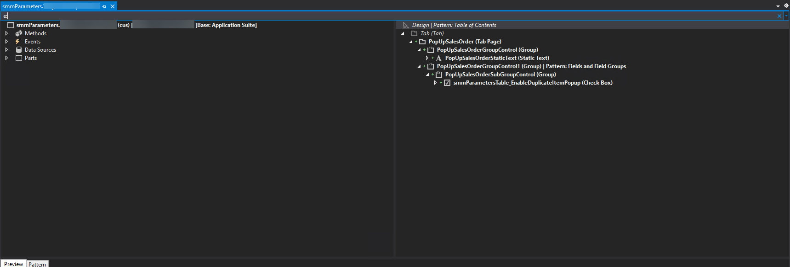
VS E: on Form Extensions

Slide 64
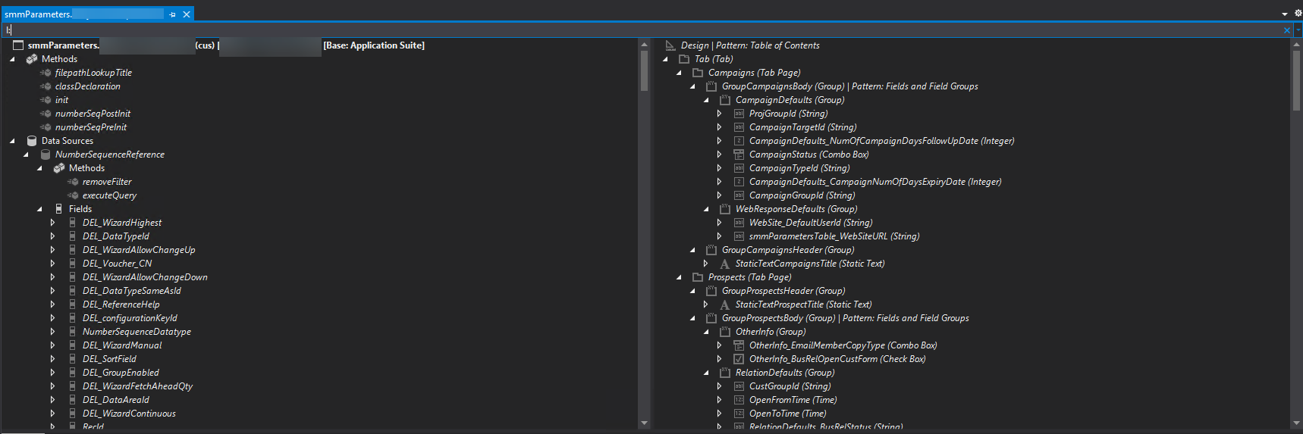
VS L: on Form Extensions

Slide 65
New Things for UDE’s

Slide 66

UDE Things
First, check out UDEs if you haven't heard of them yet
Build models, not projects or solutions
Better support for Git with configurable metadata
You get everything with your UDE so you can test your data entities in a dual write scenario, or power automate, virtual tables, etc
JIT data access
(sigh) Copilot
Microservices are available
Availability based on storage
Persistent database access?
License Usage Summary – User License

Slide 67
Resources
http://www.atomicax.com/article/d365fotools-and-vs2017-manhattan-project
https://docs.microsoft.com/en-us/dynamics365/fin-ops-core/dev-itpro/dev-ref/xpp-business-run-time-functions
https://docs.microsoft.com/en-us/dynamics365/fin-ops-core/dev-itpro/dev-ref/xpp-string-run-time-functions
https://jatomas.com/en/2020/05/02/dark-mode-visual-studio-x-code-editor/
https://dynamics365musings.com/d365-sales-order-totals/
https://www.youtube.com/watch?v=QrIjTN6Vey4&t=149s
https://sangeethwiki.blogspot.com/2017/09/extensible-controls-in-dynamics-365-for.html

Slide 68
Resources
https://ariste.info/en/2021/06/socratex-application-checker/
https://github.com/TrudAX/TRUDUtilsD365
https://devblogs.microsoft.com/powerplatform/the-unified-development-environment-is-ga/
https://learn.microsoft.com/en-us/power-platform/developer/unified-experience/finance-operations-dev-overview
https://dynamics365musings.com/x-development-boost-your-development-skills-with-proven-tips-and-tricks/

Slide 69
Questions?

Slide 70
Thanks!
Nathan Clouse
www.atomicax.com
www.dynamics.fo
@NathanClouseAX
https://www.linkedin.com/in/nathanclouseax/
Peter Ramer
www.dynamics365musings.com
https://www.linkedin.com/in/peter-ramer/

